Slide 1
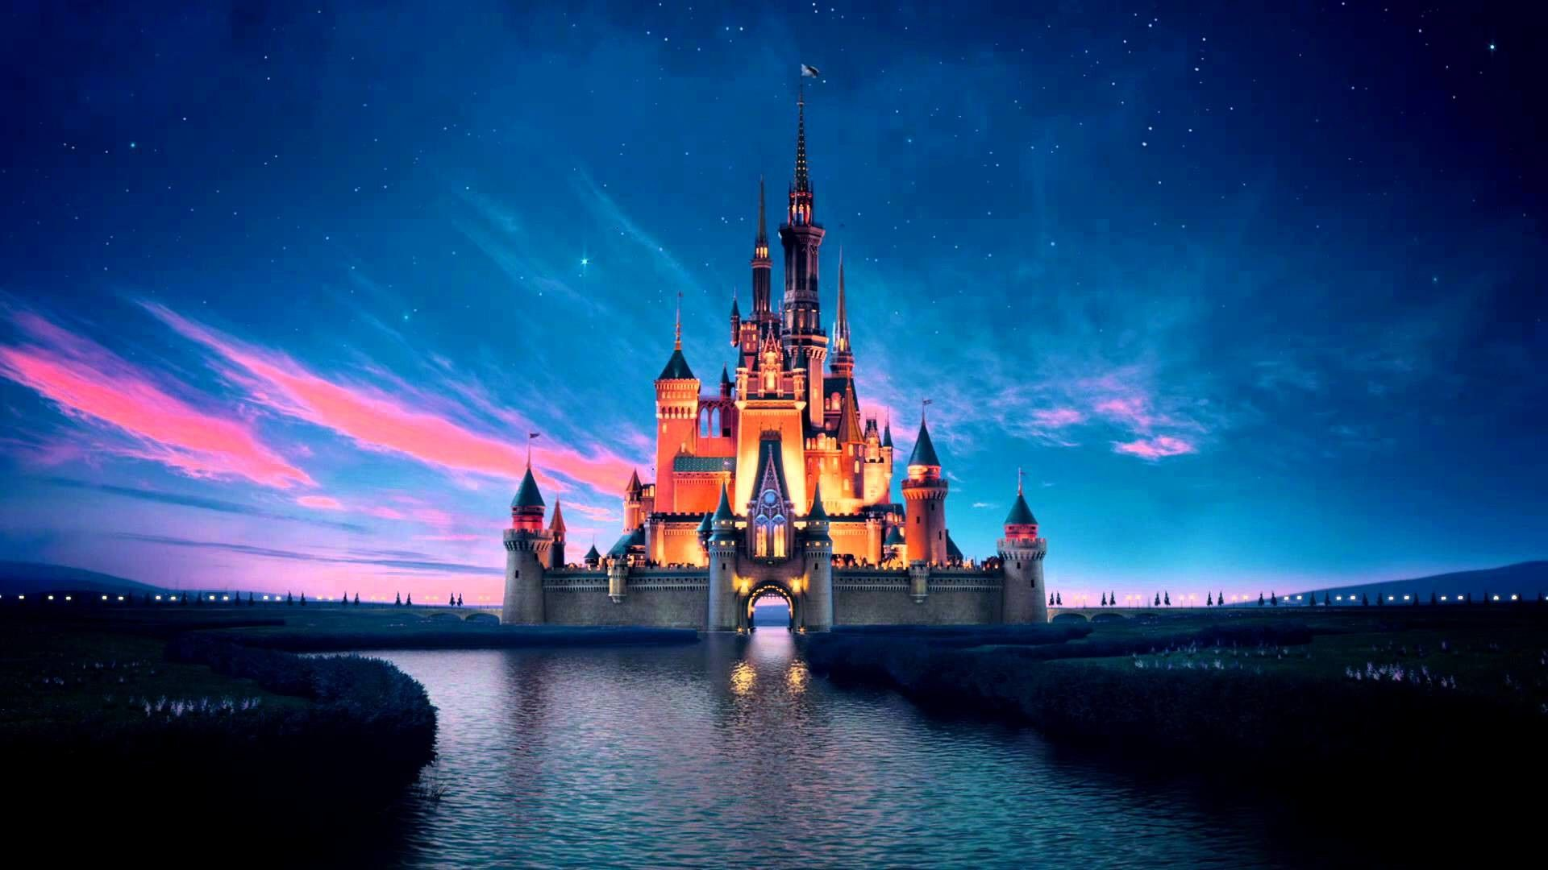

Slide 2
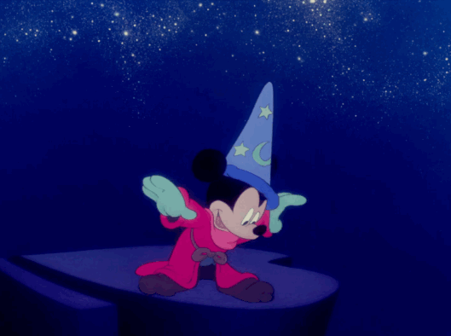
Our Team
Robin Khan
Julia Shabow
Danielle Sledge
Viktoriya Tkhoryk
Garrett Watkins
Laurel Whitten

Slide 3

Our Questions
When are most movies released?
1
2
What genre had the highest amount of movies?
3
What years had the highest gross revenue?

Slide 4
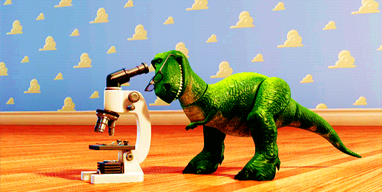
Our Hypotheses
Movies are usually released during the summer and Christmas, and on Fridays.
The action genre had the most movies released.
Gross revenue increased consistently over time.
Notes:
Why? Because families go out and see movies over the holidays.
We looked at the month that each movie was released.
December was not the month with the highest number of Disney releases.
More movies were released in March than any other month overall, in any year.
November had the second highest number of releases.
What does this mean? We believe most movies were slated for an Easter release, followed by Thanksgiving, and then Christmas.

Slide 5
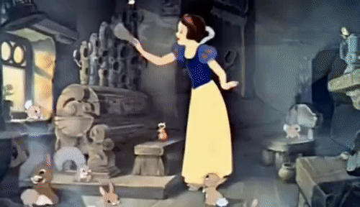
Cleaning Our Data
Removed…
Empty values for genre, revenue, or MPAA rating
Movies released prior to 1990
Total gross revenue column
Split the date into month, date, and year into separate columns
Changed titles and reordered columns

Slide 6
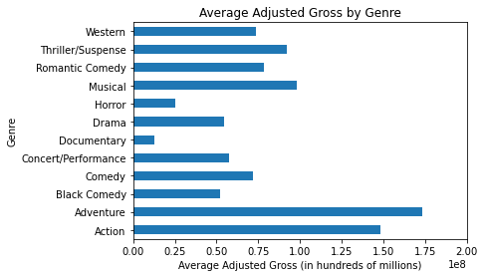
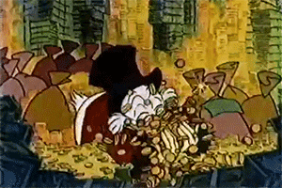
Average Adjusted Gross by Genre
Adventure had the highest average

Slide 7
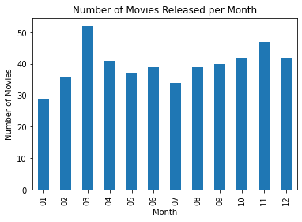

Number of Movies Released per Month
March and November had the highest number of releases

Slide 8
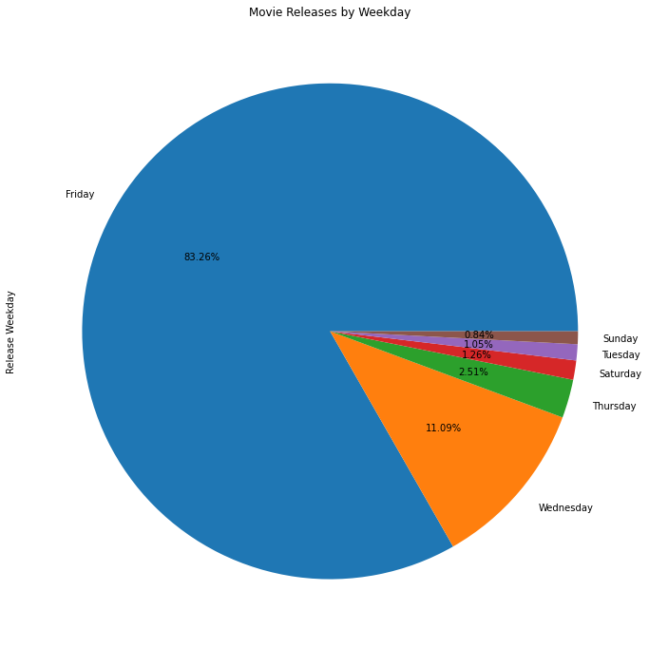
Movie Releases by Weekday
Friday and Wednesday were most common

Slide 9
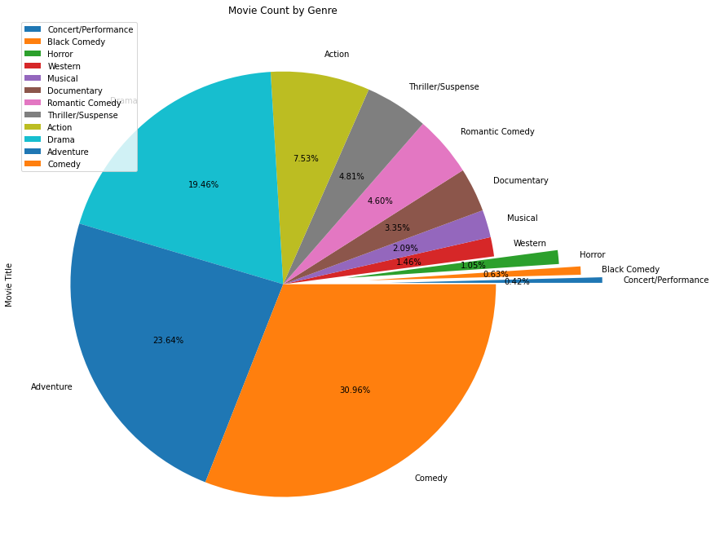
Movie Count by Genre
Comedy and Adventure have the most movies

Slide 10
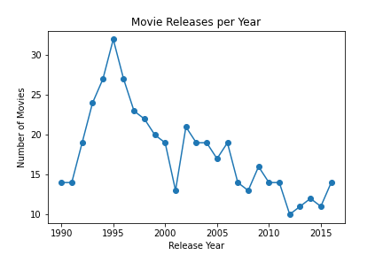
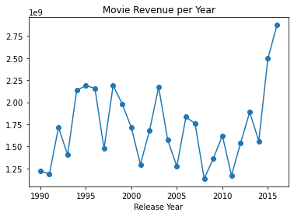
The highest number of movies released in a year was in 1995 with 32 movies released
Although 1995 did release the most amount of movies, 2016 was the highest grossing year with only 14 movies released but 2.8 billion in revenue

Slide 11

Top 5 Grossing Movies
Star Wars Ep. VII The Force Awakens
The Lion King
The Avengers
Pirates of the Caribbean: Dead Man’s Treasure
Rogue One: A Star Wars Story

Slide 12

Bottom 5 Grossing Movies
Waking Sleeping Beauty
An Alan Smithee Film: Burn Hollywood…
Gedo Senki (Tales from Earthsea)
Walt and El Grupo
Zokkomon

Slide 13


